Slide 1
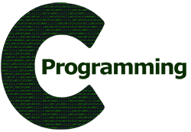
CSE101 Computer Programming
Lecture #0

Slide 2
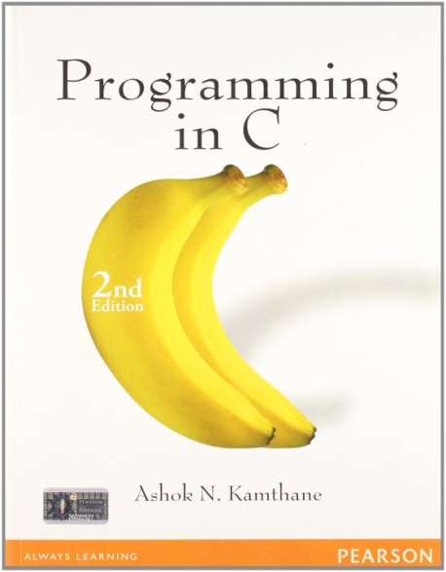
Course Details
Text Book
“PROGRAMMING IN C”
by
ASHOK N. KAMTHANE
PEARSON, 2nd Edition
L | T | P
2 | 0 | 2

Slide 3
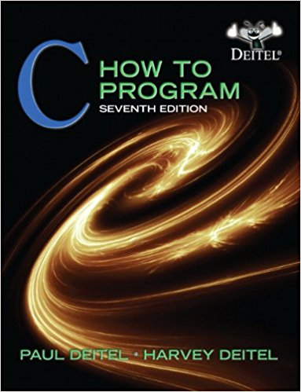
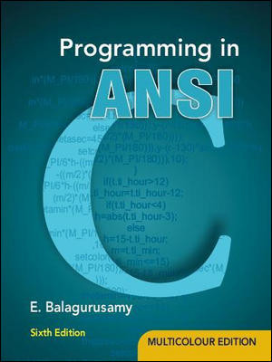
Reference Books
“C HOW TO PROGRAM” by
PAUL DEITEL AND
HARVEY DEITEL
PHI(Prentice Hall India)
“PROGRAMMING IN ANSI C”
By E. BALAGURUSAMY
McGraw Hill Education

Slide 4


Syllabus and Instruction Plan(IP)

Slide 5
Course Assessment Model
Marks break up
Attendance 5
Academic Task 25
MTE 20
ETE 50
Total 100

Slide 6
Academic Task
Component Week
Online Assignment 3 5th
Online Assignment 2 9th
Online Assignment 3 11th
Total Weeks: 14( 7 Before MTE and 7 After MTE)

Slide 7
Mode of Conduct
BYOD(Bring your own device)
Note: Laptops are mandatory for program implementation.

Slide 8



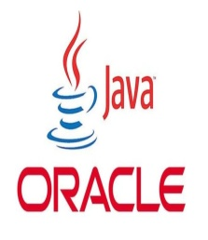
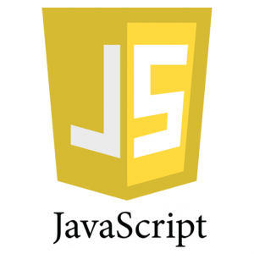
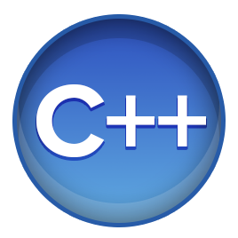
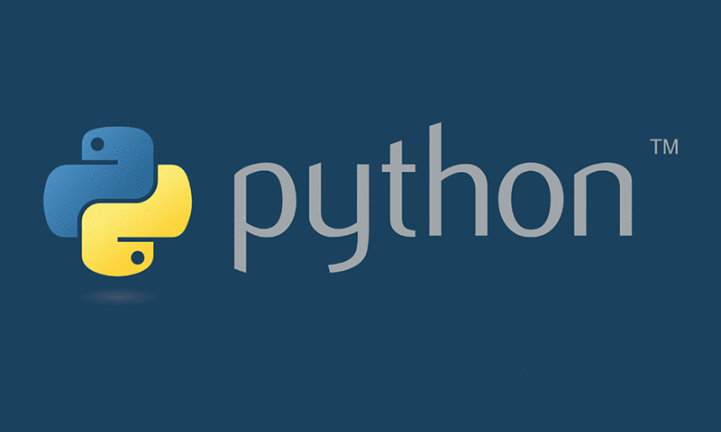
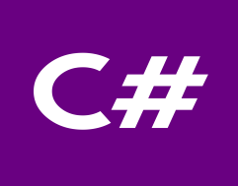
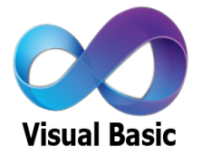
WHY C???????????????
If we have number of powerful programming languages available with us then why c??????

Slide 9


The hitch...............
Some burning questions in mind......
C is a very old language. Why are we still studying this language??????
Now, we have very powerful languages with us then, why c??
There is no scope of this language in industry

Slide 10


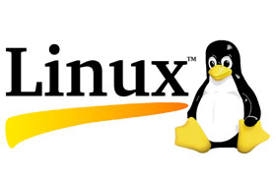


Lets take you close to the reality
All of us use Computers or Laptops for different purposes.
Could you tell me which system software is most required to get our system in working mode??????

Slide 11
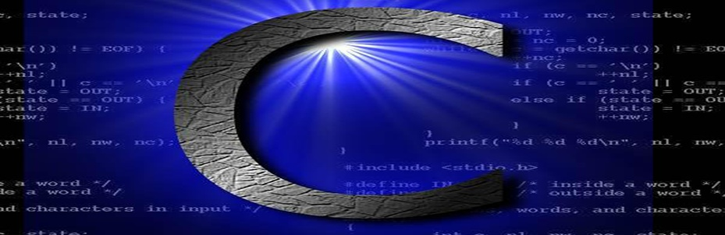
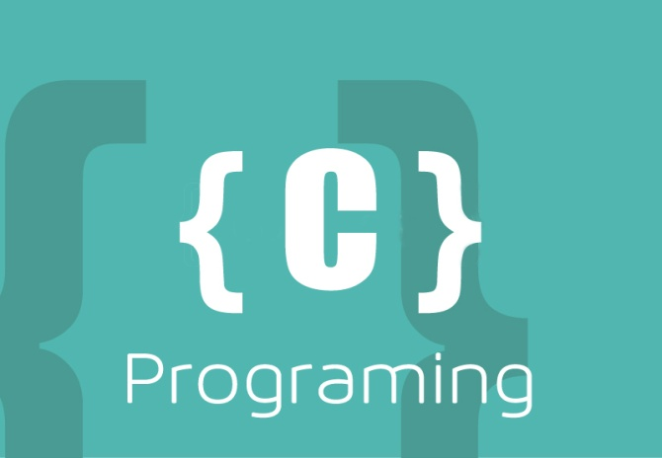
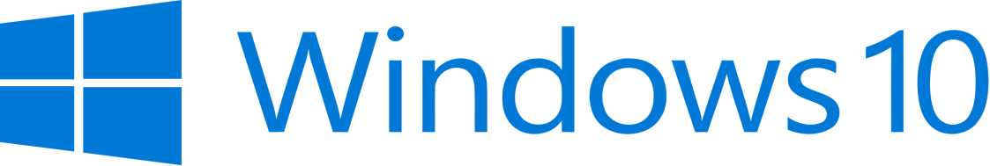
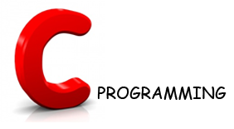
Let’s Explore more
Could you tell me which programming language is used in writing all these operating system??????
Latest version of Microsoft Windows i.e. Windows10 is still being written in C Language

Slide 12
Contd.....
Device drivers are also written in C language.
All these modern programming languages are influenced by C language
Compilers for Python and PHP language are also written in C language

Slide 13
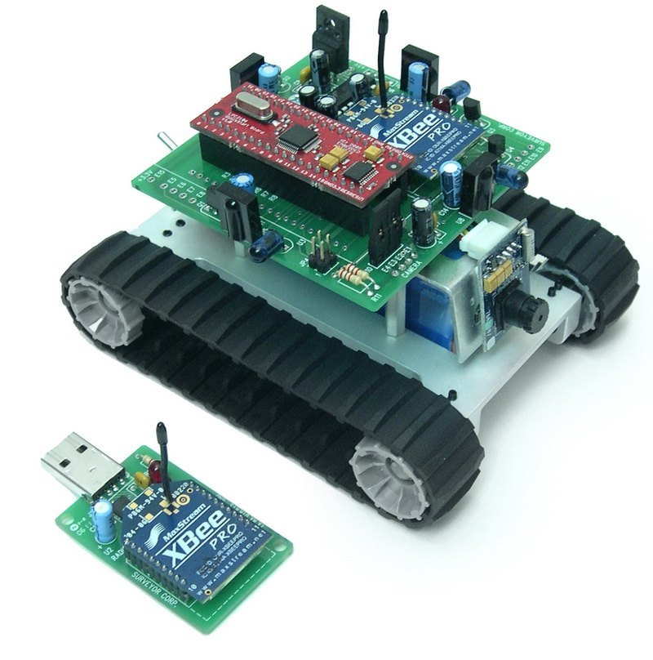
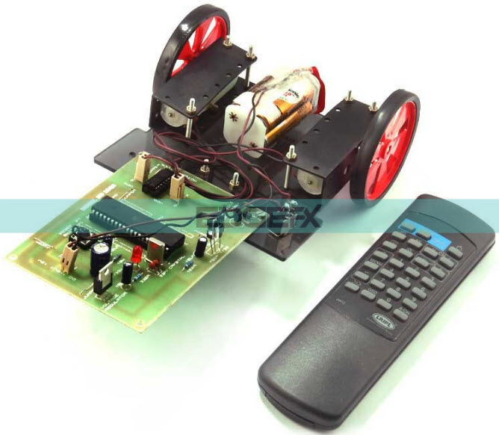
Contd.....
Embedded systems are also developed with the help of C language

Slide 14

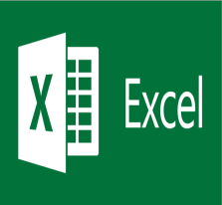




Contd.....
Git
 | Microsoft Excel
Oracle Database
 | MySql
Linux
 | Unix
Android
 | Google

Slide 15



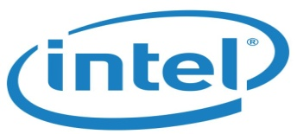

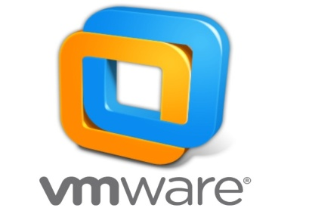
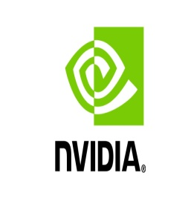




MNCs
Top rated Companies which has a dearth of C programmers

Slide 16


Here are the Answers of Questions
C is very a old language still, why do we study C language??
Now, we have very powerful languages
with us then why c??
There is no scope of this language in industry
Basic Pillar
Scope for Experts always Exists

Slide 17
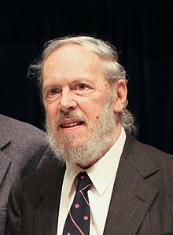
History of C
Guys Can you make a sentence with the word ‘Necessity’
“Necessity is the mother of invention”
Dennis Ritchie and Ken Thompson were working on developing a new operating system i.e UNIX
But the programming language they
were using was not providing them
the portability feature
So Dennis Ritchie developed new
language i.e C

Slide 18
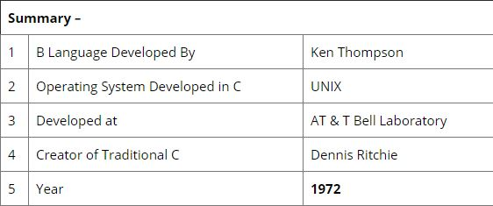
History continued...

Slide 19
Why “C” name was given???
Many of C’s principles and ideas were derived from the earlier language B. (Ken Thompson was the developer of B Language.)
BCPL and CPL are the earlier ancestors of B Language
CPL is Combined Programming Language. In 1967, BCPL Language ( Basic CPL ) was created as a scaled down version of CPL
As many of the features were derived from “B” Language thats why it was named as “C”.
After 7-8 years C++ came into existence which was first example of object oriented programming .

Slide 20
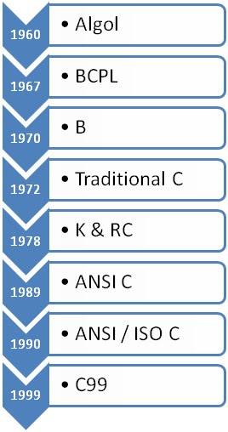
Evolution of C...

Slide 21
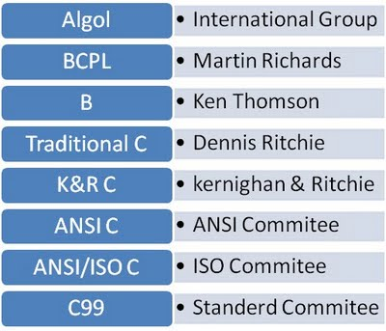
Language Developers

Slide 22
Features of C Language
Low Level Language Support
Program Portability
Powerful and Feature rich
High Level Features
Modular Programming

Slide 23
Applications of C
Used for creating computer applications
Used in writing embedded software
Development of Simulators
Used for creating compilers
Used to implement different operating system operations
UNIX kernel is completely developed in C language

Slide 24
Course Contents
Before MTE
Data Types & Operators Control Structures
User Defined Functions Storage Classes
After MTE
Arrays and Strings Pointers
Dynamic Memory Allocation Derived Data Types- Structures and Union

Slide 25


Basics and introduction to C
Program Development in C

